Slide 1

Computational Stratification of BRCA1 Missense Variants: Defining Mechanisms of Pathogenicity for Precision Oncology
Submitted by: Ankesh Bashist
(Roll No: 2418947)
MSc. Biotechnology | Chandigarh Group of Colleges, Landran
Submitted to: Bhairiv Parshad

Slide 2
Introduction
Breast-Ovarian cancer
Breast Cancer
Breast cancer is one of the most common cancers affecting women worldwide. It develops when breast cells grow uncontrollably and form malignant tumors. Mutations in BRCA1 and BRCA2 are major genetic risk factors
Ovarian cancer
Ovarian cancer is one of the most lethal gynaecological cancers worldwide. It originates from abnormal growth of cells in the ovaries. Early-stage ovarian cancer often shows few or no symptoms, making diagnosis difficult. Genetic factors play a significant role in disease development. Mutations in the BRCA1 and BRCA2 genes significantly increase ovarian cancer risk.
BRCA1 Gene
Located on chromosome 17q21 in humans.
Encodes a 1863-amino-acid tumor suppressor protein. Plays a crucial role in the repair of DNA double-strand breaks through homologous recombination. Maintains genomic stability and prevents accumulation of mutations. Contains two important functional domains:
RING domain (protein-protein interactions and ubiquitin ligase activity)
BRCT domain (DNA damage response and repair signaling )
Pathogenic BRCA1 mutations increase the risk of breast and ovarian cancer.

Slide 3
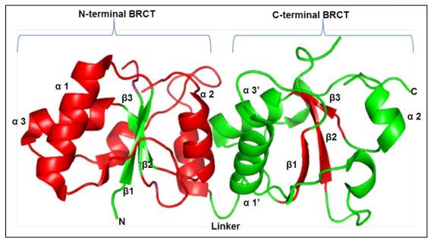
Structure and Functional Domains of BRCA1
RING Domain
Located at the N-terminal region (aa 24–65).
Forms a heterodimer with BARD1.
Responsible for protein–protein interactions.
Exhibits E3 ubiquitin ligase activity.
Essential for BRCA1 tumor suppressor function.
BRCT Domain
Located at the C-terminal region (aa 1646–1855).
Recognizes phosphorylated proteins.
Involved in DNA damage signalling.
Regulates cell-cycle checkpoints and critical for DNA repair through homologous recombination.
Functions of BRCA1
Repairs DNA double-strand breaks and maintains genomic stability.
Regulates cell-cycle progression.
Participates in transcriptional regulation.
Prevents accumulation of cancer-causing mutations.

Slide 4
Research Gap
Although numerous BRCA1 variants have been reported in public databases, the functional significance of many missense mutations remains incompletely understood. Experimental validation of every variant is costly and time-consuming. Furthermore, comparative analyses integrating multiple bioinformatics prediction tools and structural assessment are limited for several BRCA1 variants. Therefore, there is a need for computational studies that evaluate the potential pathogenicity and structural consequences of BRCA1 mutations to prioritize variants for future experimental investigation.
BRCA1 Variants
↓
Unknown Significance
↓
Bioinformatics Analysis
↓
Potentially Pathogenic Variants

Slide 5
Objectives
.
Retrieve Variants from ClinVIR
Pathogenticity predicition (PolyPhen-2)
Variant assessment (mutation testing)
Comparative analysis
Structural analysis
In this study, selected BRCA1 variants linked to breast cancer were collected from the ClinVar database. These variants were analyzed using PolyPhen-2 and MutationTaster to determine whether they could affect the normal function of the BRCA1 protein. Structural analysis was also performed to understand how specific mutations may alter protein stability and structure. The results from different tools were then compared to identify variants that are most likely to be harmful.

Slide 6
PolyPhen-2 & Mutation testing scores
Variant | PolyPhen Prediction | PolyPhen Score | Protein Change | cDNA Change | ClinVar ID | MutationTaster Prediction | MT Probability
M18R | Probably Damaging | 0.972 | p.Met18Arg | c.53T>G | VCV000531241.14 | polymorphism | 0.608975005
T1712I | Probably Damaging | 0.683 | p.Thr1712Ile | c.5135C>T | VCV000037628.32 | disease causing | 0.999998726
W1739C | Probably Damaging | 0.999 | p.Trp1739Cys | c.5217G>C | VCV000055435.40 | disease causing | 1
D1760Y | Probably Damaging | 0.974 | p.Asp1760Tyr | c.5278G>T | VCV000055464.12 | disease causing | 0.993136084057622
G1788V | Benign | 0.193 | p.Gly1788Val | c.5363G>T | VCV000037660.33 | disease causing | 1
W1858R | Probably Damaging | 1 | p.Trp1858Arg | c.5572T>C | VCV000037679.63 | polymorphism | 1
C61G | Benign | 0.116 | p.Cys61Gly | c.181T>G | VCV000017661.158 | disease causing | 0.999972352
R1699W | Probably Damaging | 0.999 | p.Arg1699Trp | c.5095C>T | VCV000055396.99 | disease causing | 0.999963667
M1775R | Probably Damaging | 0.648 | p.Met1775Arg | c.5324T>G | VCV000017694.51 | disease causing | 1
L1839S | Probably Damaging | 0.998 | p.Leu1839Ser | c.5516T>C | VCV000091656.22 | disease causing | 0.999947956

Slide 7
PolyPhen Score
PolyPhen-2 analysis showed that most of the selected BRCA1 variants are likely to affect protein function. Out of the ten variants analyzed, eight were classified as probably damaging, while two were predicted to be benign. The highest pathogenicity scores were observed for W1858R (1.000), W1739C (0.999), and R1699W (0.999), indicating a strong likelihood of disrupting normal BRCA1 protein activity.

Slide 8
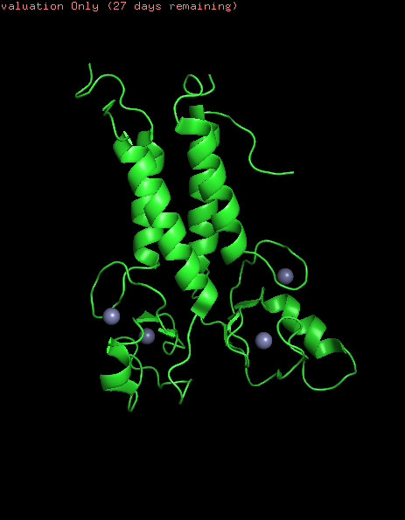
Structural Analysis of C61G
Structural analysis of the C61G mutation revealed a significant change in the BRCA1 RING domain. In the wild-type protein, Cys61 helps coordinate a zinc ion (Zn²⁺), which is essential for maintaining the structural stability of the RING domain. Replacement of cysteine with glycine removes the sulfur-containing side chain required for zinc binding. As a result, zinc coordination is disrupted, leading to local structural instability and potential loss of BRCA1 function.

Slide 9
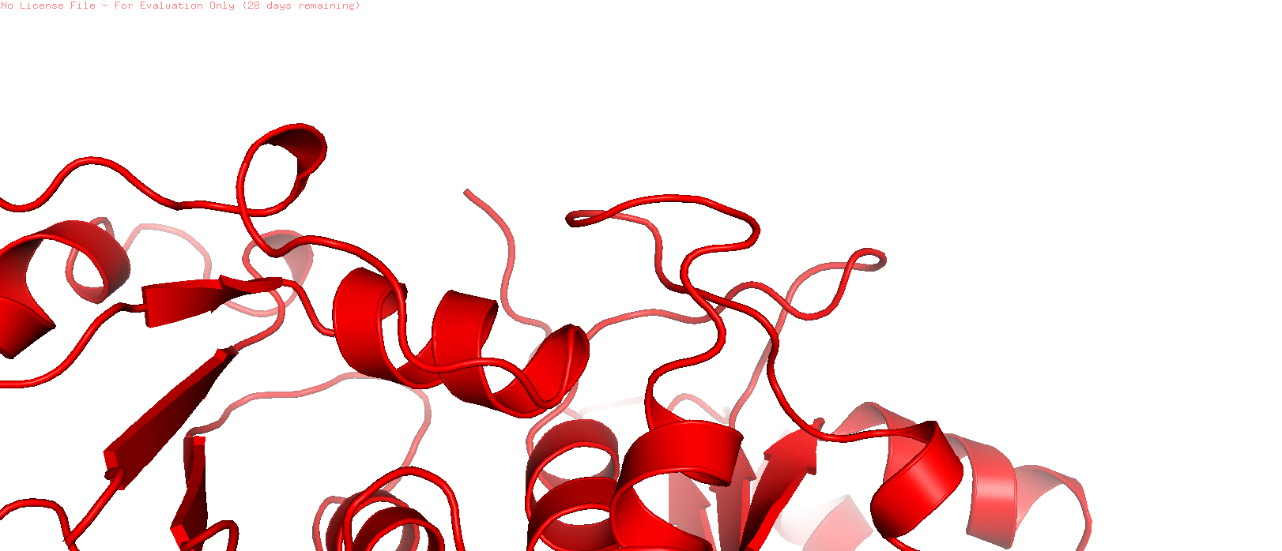
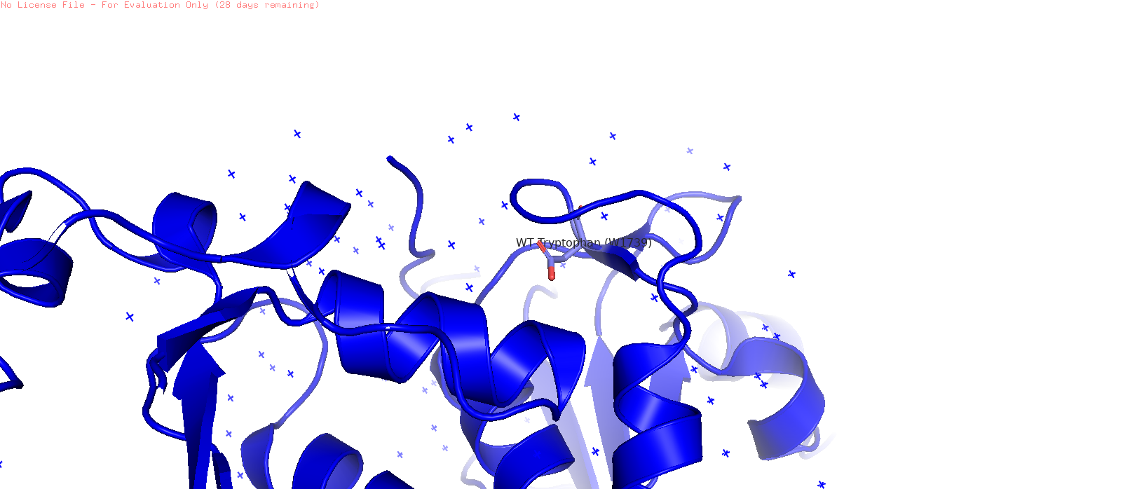
Structural Analysis of W1739C
The W1739C mutation is located within the BRCT domain of the BRCA1 protein, a region that plays a critical role in DNA damage recognition and repair. In the wild-type protein, tryptophan (Trp1739) is a large aromatic amino acid that contributes to the stability of the BRCT domain through hydrophobic interactions with neighboring residues. Substitution of tryptophan with cysteine results in the loss of the bulky aromatic side chain and introduces a smaller sulfur-containing residue. This alteration may disrupt local hydrophobic interactions and affect the structural integrity of the BRCT domain. Consequently, the mutation is predicted to impair protein–protein interactions involved in DNA repair signaling, potentially reducing BRCA1 function and increasing cancer susceptibility.
mutated BRCT domain
Non mutated BRCT domain

Slide 10
Summary of Major Findings
Finding | Observation
Variants analyzed | 10
Probably Damaging (PolyPhen-2) | 8
Benign (PolyPhen-2) | 2
Disease Causing (MutationTaster) | 8
Polymorphism (MutationTaster) | 2
RING Domain Variants | 2
BRCT Domain Variants | 8
Analysis of ten BRCA1 variants revealed that the majority are predicted to have a deleterious effect on protein function. Eight variants were classified as probably damaging by PolyPhen-2, while MutationTaster identified eight variants as disease-causing. Most mutations were located within the BRCT domain, highlighting its importance in maintaining BRCA1-mediated DNA repair functions. Structural analyses further demonstrated how specific amino acid substitutions may compromise protein stability and activity.

Slide 11
CONCLUSION
Ten BRCA1 missense variants were successfully analyzed using bioinformatics tools.
PolyPhen-2 and MutationTaster predicted that most variants are potentially pathogenic.
The majority of the selected variants were located within the BRCT domain, highlighting its importance in DNA repair.
Structural analysis of selected variants revealed potential effects on protein stability and function.
Bioinformatics approaches provide a rapid and cost-effective strategy for prioritizing variants for further experimental studies.
Most BRCA1 variants examined in this study showed potential pathogenic effects. These findings highlight the importance of bioinformatics tools in identifying mutations associated with hereditary breast and ovarian cancer.

Slide 12
Future Scope
The present study provides a computational assessment of selected BRCA1 variants; however, further experimental validation is required to confirm their biological effects. Future studies may incorporate molecular dynamics simulations, protein interaction analyses, and larger variant datasets to gain deeper insights into the role of BRCA1 mutations in cancer development. Such approaches may contribute to improved genetic diagnosis and personalized treatment strategies.

Slide 13
References
AlphaMissense Consortium. (2023). Predicting the effects of missense variants in the human genome with AlphaMissense. Science, 381(6664), eadg7492.
wissmodel.expasy.org
wissmodel.expasy.org
https://www.ncbi.nlm.nih.gov/
https://www.rcsb.org
https://www.ncbi.nlm.nih.gov/clinvar/variation/55396/
Brzovic, P. S., Rajagopal, P., Hoyt, D. W., King, M. C., & Klevit, R. E. (2001). Structure of a BRCA1–BARD1 heterodimeric RING–RING complex. Nature Structural Biology, 8(10), 833–837. 🔗 DOI: https://doi.org/10.1038/nsb1001-833.
Endometrial cancer risk in women with germline BRCA1 or BRCA2 mutations: multicenter cohort study. Journal of the National Cancer Institute, 113(9), djab036. https://doi.org/10.21203/rs.3.rs-1942605/v1
Farmer et al. (2005)Farmer, H., McCabe, N., Lord, C. J., Tutt, A. N., Johnson, D. A., Richardson, T. B., et al. (2005). Targeting the DNA repair defect in BRCA mutant cells as a therapeutic strategy. Nature, 434(7035), 917–921. 🔗 DOI: https://doi.org/10.1038/nature03445
Findlay, G. M., Daza, R. M., Martin, B., Zhang, M. D., Leith, A. P., Gasperini, M., et al. (2018). Accurate classification of BRCA1 variants with saturation genome editing. Nature, 562(7726), 217–222. 🔗 DOI: https://doi.org/10.1038/s41586-018-0461-z
Hashizume, R., Fukuda, M., Maeda, I., Nishikawa, H., Oyake, D., Yabuki, Y., et al. (2001). The RING heterodimer BRCA1–BARD1 is a ubiquitin ligase inactivated by a breast cancer-derived mutation. The Journal of Biological Chemistry, 276(18), 14537–14540. 🔗 DOI: https://doi.org/10.1074/jbc.C000881200
Lord, C. J., & Ashworth, A. (2017). PARP inhibitors: Synthetic lethality in the clinic. Science, 355(6330), 1152–1158. 🔗 DOI: https://doi.org/10.1126/science.aam7344
Miki, Y., Swensen, J., Shattuck-Eidens, D., Futreal, P. A., Harshman, K., Tavtigian, S., et al. (1994). A strong candidate for the breast and ovarian cancer susceptibility gene BRCA1. Science, 266(5182), 66–71. 🔗 DOI: https://doi.org/10.1126/science.7545954
Moynahan, M. E., Chiu, J. W., Koller, B. H., & Jasin, M. (1999). BRCA1 controls homologous recombination. Molecular Cell, 4(4), 511–518. 🔗 DOI: https://doi.org/10.1016/S1097-2765(00)80202-6
Schreiber, S. L. (2021). The rise of molecular glues. Cell, 184(1), 3–9. 🔗 DOI: https://doi.org/10.1016/j.cell.2020.12.020
RCSB Protein Data Bank. BRCA1/BARD1 RING Domain Heterodimer. PDB ID: 1JM7. 🔗 https://doi.org/10.2210/pdb1JM7/pdb
RCSB Protein Data Bank. Tandem BRCT Domains of Human BRCA1 Bound to Phosphopeptide. PDB ID: 1T15. 🔗 https://doi.org/10.2210/pdb1T15/pdb

